Slide 1
Digital image processing and analysis 11. Object properties: counting, measuring and localisation
Professor Ela Claridge
School of Computer Science

Slide 2
Previous lecture:
Post-processing methods
Mathematical morphology – basic operations
Feature extraction
Mathematical morphology – combined operations

Slide 3
In this lecture we shall find out about:
How to get coordinates of the object boundaries
Hand-on-the-wall walk around the object
How to count objects in a segmented image
How to measure objects
Area
Boundary / Perimeter
How to measure object locations
Bounding box
Centroid
How to measure some object properties
Fitted ellipse
Compactness
Concavity

Slide 4
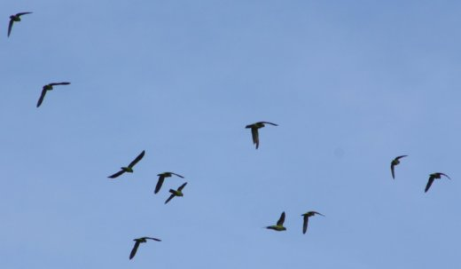
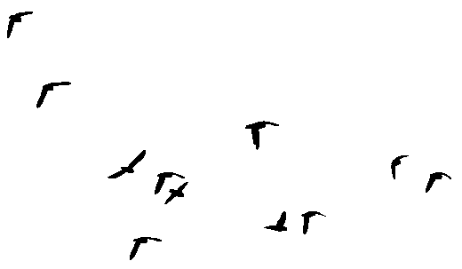
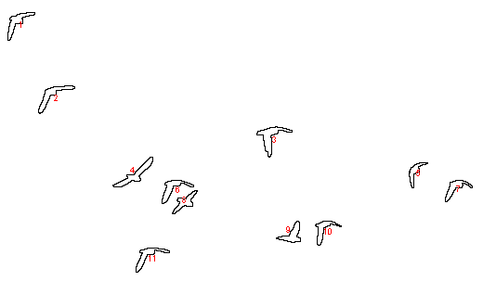
Segmentation A starting point to object measurement

Slide 5
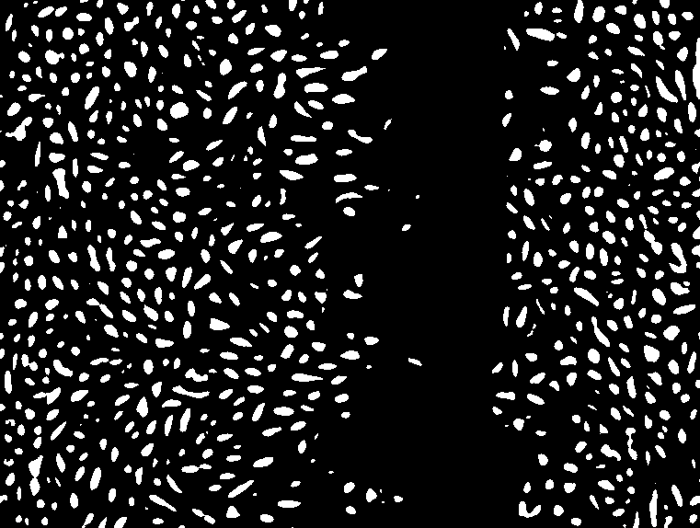
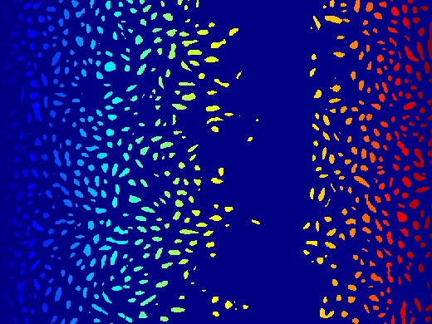
Segmentation A starting point to object measurement
Labeled image
+ cell count
Segmented image

Slide 6
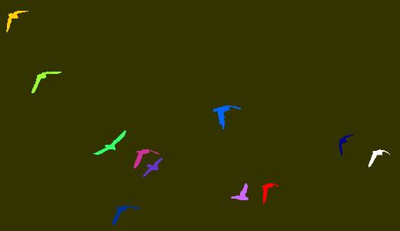
Segmentation A starting point to object measurement
Representations for a segmented image
Binary image:
pixel value = 0 for the background
pixel value = 1 for (any) object
Label image:
pixel value = 0 for the background
pixel value = object number
(each colour represents different number)

Slide 7
Segmentation A starting point to object measurement
Binary segmented image
Labelled image
Number of objects
For each object
Area
Perimeter
Location
… etc. …

Slide 8
Object boundary extraction Region outlining
Used to obtain information about the edge of a region extracted by one of the region segmentation techniques (e.g. thresholding)
No a priori knowledge is required about a shape.
Useful as a pre-processing step for shape description.

Slide 9
Object boundary extraction Region outlining
One of the simplest techniques is the "hand on the wall" approach
Produces not only an image with the pixels showing the outline but also a list of (x,y) coordinates of the outline.

Slide 10
Object boundary extraction Region outlining
 |  | o
 |  | x
 |  | o
 |  | o | x
 |  | o
 |  | o | o | o
 |  |  |  |  | o
 |  |  |  |  | o
 |  |  |  |  | o | o
 |  |  |  |  |  |  | x
 |  | o
 |  | o | o | o | o
 |  |  |  |  | o
 |  |  |  |  | o
 |  |  |  |  | o | o |  | x
 |  |  |  |  |  |  | o | o
 |  | o |  |  |  | x
 |  | o | o | o | o |  | o
 |  |  |  |  | o |  |  | o
 |  |  |  |  | o |  |  | o
 |  |  |  |  | o | o |  | o
 |  |  |  |  |  |  | o | o
 |  | o | o | o | o | o
 |  | o | o | o | o |  | o
 |  |  |  |  | o |  |  | o
 |  |  |  |  | o |  |  | o
 |  |  |  |  | o | o |  | o
 |  |  |  |  |  |  | o | o
object
seed
next pixel

Slide 11
Object boundary extraction Region outlining
Algorithm (recipe) for the Hand-on-the-wall region outlining
Scan image pixels from left to right / top down until the first object pixel is found (seed).
Add its coordinates to the list.
Consider a 3x3 region of interest (ROI) centred on the seed pixel
Starting from the top-left corner of the ROI traverse pixels around the seed pixel in anti-clock-wise direction until the first transition from background pixel to object pixel is found.
Make it a new seed.
Repeat steps from 2 to 5 until the new seed coordinate equals the first seed coordinate. The outline of this object is now complete.
Search for the new object, repeat steps 1-7 until the bottom right corner of the image is reached.

Slide 12
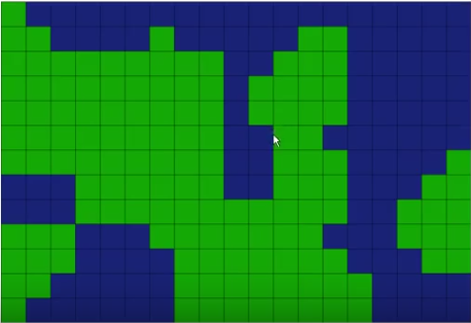
Row-by-row labelling
U-L connector
(”up-left)
Segmented image
Green: Object
Blue: background
https://www.youtube.com/watch?v=rVtFyefbJio

Slide 13
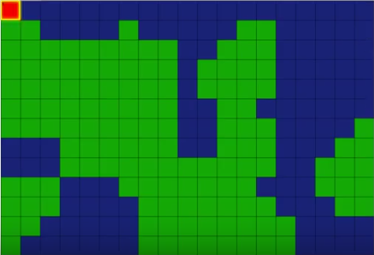
Row-by-row labelling
Region ID | Connections
1
Step 1 (first pass)
Scan left-to-right then top-to bottom
Stop when an unlabelled pixel found
If unconnected U-L, increment label number ✓
(the first one will be 1)
Update connections

Slide 14
Row-by-row labelling
Region ID | Connections
1 | 1
Step 1 (first pass)
Scan left-to-right then top-to bottom
Stop when an unlabelled pixel found
If unconnected U-L, increment label number
If connected U-L, assign the smaller label chosen out of the labels covered by the U-L connector ✓

Slide 15
Row-by-row labelling
Region ID | Connections
1 | 1
Step 1 (first pass)
Scan left-to-right then top-to bottom
Stop when an unlabelled pixel found
If unconnected U-L, increment label number ✓
If connected U-L, assign the smaller label
Update connections

Slide 16
Row-by-row labelling
Region ID | Connections
1 | 1
2 | 2
Step 1 (first pass)
Scan left-to-right then top-to bottom
Stop when an unlabelled pixel found
If unconnected U-L, increment label number ✓
If connected U-L, assign the smaller label
Update connections

Slide 17
Row-by-row labelling
Region ID | Connections
1 | 1
2 | 2
Step 1 (first pass)
Scan left-to-right then top-to bottom
Stop when an unlabelled pixel found
If unconnected U-L, increment label number ✓
If connected U-L, assign the smaller label
Update connections

Slide 18
Row-by-row labelling
Region ID | Connections
1 | 1
2 | 2
3 | 3
Step 1 (first pass)
Scan left-to-right then top-to bottom
Stop when an unlabelled pixel found
If unconnected U-L, increment label number ✓
If connected U-L, assign the smaller label
Update connections

Slide 19
Row-by-row labelling
Region ID | Connections
1 | 1
2 | 2
3 | 3
Step 1 (first pass)
Scan left-to-right then top-to bottom
Stop when an unlabelled pixel found
If unconnected U-L, increment label number ✓
If connected U-L, assign the smaller label
Update connections

Slide 20
Row-by-row labelling
Region ID | Connections
1 | 1
2 | 2
3 | 3
Step 1 (first pass)
Scan left-to-right then top-to bottom
Stop when an unlabelled pixel found
If unconnected U-L, increment label number
If connected U-L, assign the smaller label ✓
Update connections

Slide 21
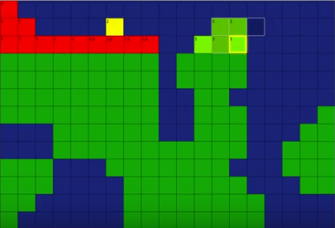
Row-by-row labelling
Region ID | Connections
1 | 1,2
2 | 1,2
3 | 3
Step 1 (first pass)
Scan left-to-right then top-to bottom
Stop when an unlabelled pixel found
If unconnected U-L, increment label number
If connected U-L, assign the smaller label ✓
Update connections

Slide 22
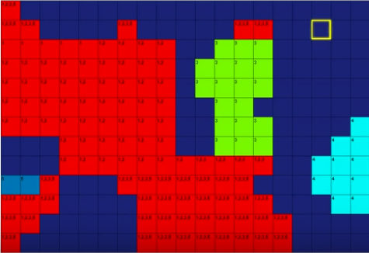
Row-by-row labelling
Region ID | Connections
1 | _{1,2,3}
2 | _{1,2}
3 | _{1,3}
4 | ₄
5 | ₅
Step 2 (second pass):
If a region has connections other than itself, change it to the lowest number

Slide 23
Row-by-row labelling
Region ID | Connections
1 | 1,2,3
2 | 1,2
3 | 1,3
4 | 4
5 | 5
Step 2 (second pass):
If a region has connections other than itself, change it to the lowest number

Slide 24
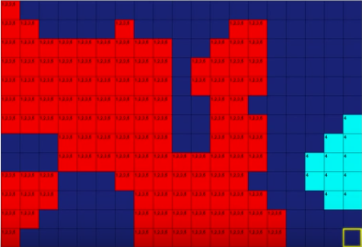
Row-by-row labelling
Region ID | Connections
1 | 1
2 | 1
3 | 1
4 | 4
5 | 5
5
Final labels

Slide 25
Row-by-row labelling
Region ID | Connections
1 | 1
2 | 1
3 | 1
4 | 4
5 | 5
5
Final labels
https://www.youtube.com/watch?v=rVtFyefbJio

Slide 26
Labelling
Row-by-row labelling is one of many labelling methods.
Other methods include
Connected component labelling
Recursive labelling
Union-find structure
Run-Length encoding

Slide 27
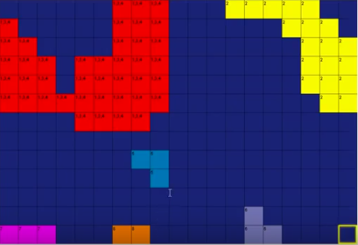
Object area
Region ID | Count
1 | 1
2
3
4
5
6
Region ID | Count
1
2
3
4
5

Slide 28
Object area
Region ID | Count
1 | 3
2
3
4
5
6

Slide 29
Object area
Region ID | Count
1 | 3
2
3
4
5
6

Slide 30
Object area
Region ID | Count
1 | 3
2 | 5
3
4
5
6

Slide 31
Object area
Region ID | Count
1 | 41
2 | 19
3 | 3
4 | 3
5 | 2
6 | 3

Slide 32
Object area
Algorithm
Set up a count table for a given number of objects
For each object set the count to zero
Scan pixels left-to-right then top-to bottom
Get pixel label
Increment the pixel count for this label

Slide 33
Object perimeter
Scan left-to-right then top-to bottom
Stop when a labelled pixel found
Save the pixel’s coordinate

Slide 34
Object perimeter
Follow the contour using the “hand-on-the-wall” algorithm

Slide 35
Object perimeter
Continue following the contour until the current pixel has the same coordinates as the first pixel.
Keep saving the coordinates of each new pixel on the contour.

Slide 36
Object perimeter
Continue to the next label and repeat the outlining.
Stop when the contours for all the labelled regions are found.

Slide 37
Object locations Bounding box
The bounding box (minimum bounding rectangle, or envelope), is a set of coordinates defining the minimum and maximum x- and y- coordinates of an object.
Computation:
In the list of object coordinates find:
Minimum x-coordinate (x1)
Maximum x-coordinate (x2)
Minimum y-coordinate (y1)
Maximum y-coordinate (y2)
Width: x2 – x1 +1
Height: y2 – y1 +1
The coordinates of the bounding box are as shown on the right.
(x1,y1)
(x2,y1)
(x1,y2)
(x2,y2)

Slide 38
Object locations Bounding box
Bounding boxes for a sample labelled image

Slide 39
Object locations Object centre
Object centre can be defined in a number of ways.
The most common are
Centre of the bounding box
Centre of mass

Slide 40
Object locations Object centre: centre of the bounding box
Cx = (x2 – x1) / 2
Cy = (y2 – y1) / 2
(x1,y1)
(x2,y1)
Note:
The centre can lie outside the object pixels
The coordinates can be fractional
(x1,y2)
(x2,y2)

Slide 41
Object locations Object centre: centre of the bounding box
Is this a better bounding box?
Fitted ellipse may also be an answer
(see later)

Slide 42
Object locations Object centre: centre of mass
Sx = sum of all the object x coordinates
Sy = sum of all the object y coordinates
N = number of pixel in the object
Cx = Sx / N
Cy = Xy / N
Sx=3+4+5+6+7+
6+7+8+
7+8+9+
7+8+9+
7+8+9+
8+9 = 135
Sy = 4+4+ … + 8+9 = 116
N = 19
Cx = 7.1
Cy = 6.1
(3,4)

Slide 43
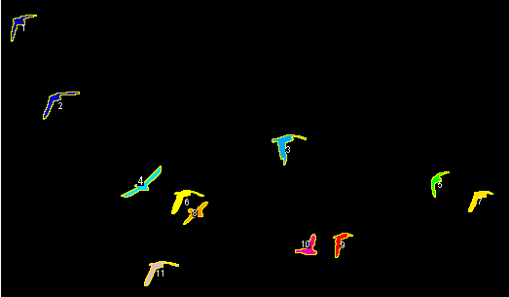
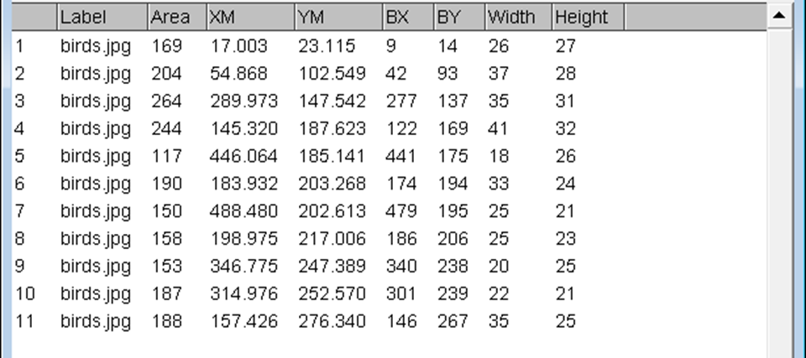
Geometric measurements FIJI examples
Centre of mass
Bounding box

Slide 44

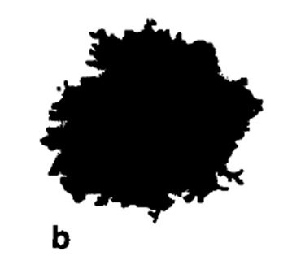
Geometric measurements FIJI examples
Object 1
Object 2
Geometric centre
Centre of mass
Bounding box
Object | Area | X | Y | XM | YM | Perim. | BX | BY | Width | Height
1 | 20930 | 99.71 | 104.13 | 99.71 | 104.12 | 844 | 0 | 0 | 214 | 208
2 | 17570 | 104.19 | 93.07 | 104.2 | 93.11 | 808 | 0 | 0 | 212 | 192

Slide 45

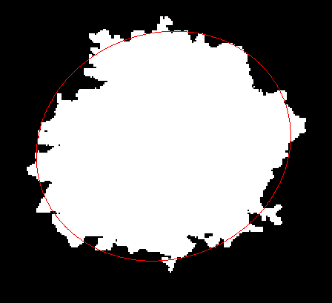
Geometric measurements FIJI: Fitted ellipse parameters
Fitted ellipse axes
Circularity
Aspect ratio
 | Major | Minor | Angle | Circ. | %Area | AR | Round | Solidity
1 | 184.43 | 144.49 | 99.59 | 0.37 | 47.02 | 1.28 | 0.78 | 1
2 | 160.1 | 139.73 | 20.8 | 0.34 | 43.17 | 1.15 | 0.87 | 1

Slide 46
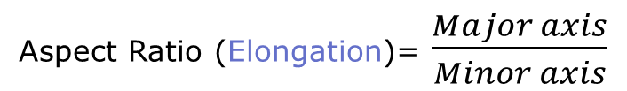
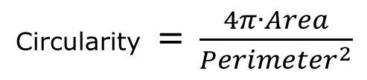
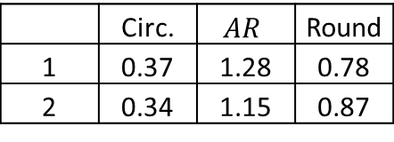
Geometric measurements FIJI: Fitted ellipse parameters
 | Circ. | $$AR$$ | Round
1 | 0.37 | 1.28 | 0.78
2 | 0.34 | 1.15 | 0.87
Circularity = $\frac{4π∙Area}{{Perimeter}^{2}}$
Aspect Ratio (Elongation)= $\frac{Major axis}{Minor axis}$
Perfect circle = 1
Decreases towards 0.0 for an increasingly elongated shape.
Roundness = inverse of Circularity

Slide 47

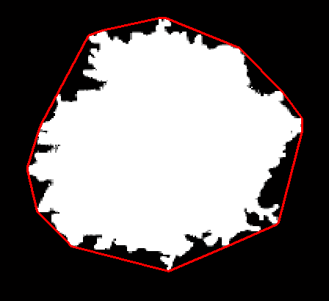
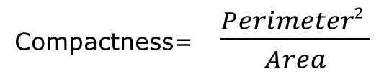
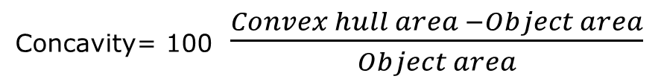
Geometric measurements Other parameters
 | Comp. | Conc.
1 | 34.03 | 1.19
2 | 37.16 | 17.46
Compactness= $\frac{Perimeter2 }{Area}$
Concavity= 100 $\frac{Convex hull area −Object area}{Object area}$
Convex hull of a binary object - the smallest convex polygon that contains the object.

Slide 48
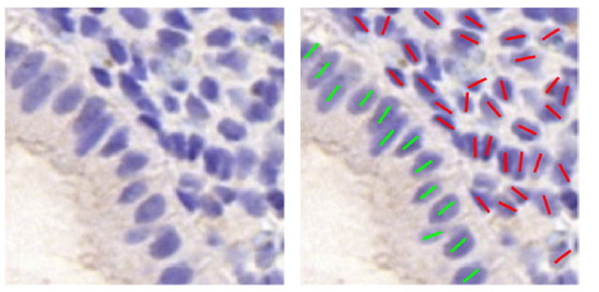
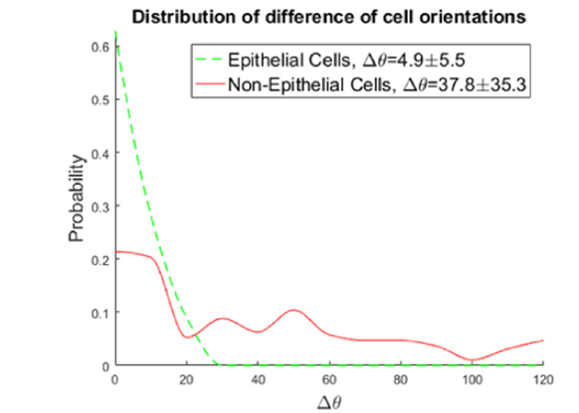
Geometric measurements Fitted ellipse parameters: application
G. Li et al. / Medical Image Analysis 37 (2017) 91–100

Slide 49
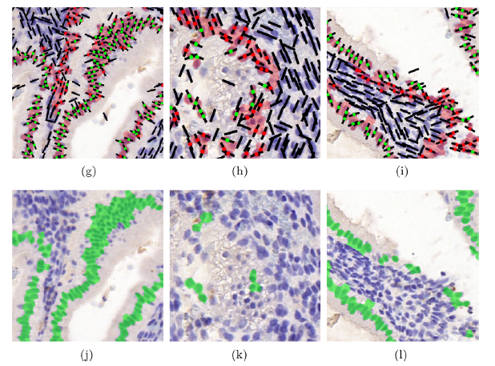
Geometric measurements Fitted ellipse parameters: application
Histological sample segmentation based on the orientation of cells.
Correctly segmented into different tissue types.

Slide 50
In this lecture we have covered:
How to get coordinates of the object boundaries
How to count objects in a segmented image
How to measure objects
How to measure object locations
How to measure some object properties

Slide 51
Next lecture:
Further object properties – descriptors and methods
Shape
Outlines
Geometric features (e.g. curvature)
Fractal dimension
Texture
Grey level statistics
Co-occurrence matrices
From segmented images to segmented object properties

Slide 52
Further reading and experimentation
Book chapters:
Gonzalez, R.C. & Woods, R.E. Digital Image Processing, Addison-Wesley (various editions), 7.4.2, 8.1.1.
Sonka, M. Hlavac, V. Boyle, R. (various editions) Image Processing, Analysis and Machine Vision, Chapman & Hall Computing, 6.2.1.
Umbaugh, S.E. Computer vision and image processing : a practical approach using CVIPtools , Prentice Hall International (various editions), 2.4.2, 2.4.3.
Boundary tracing
http://www.imageprocessingplace.com/downloads_V3/root_downloads/tutorials/contour_tracing_Abeer_George_Ghuneim/alg.html
Binary object properties
https://courses.cs.washington.edu/courses/cse576/book/ch3.pdf
HIPR2 resources
Pixel labelling
http://homepages.inf.ed.ac.uk/rbf/HIPR2/label.htm

